Slide 1
Blame
Seminar 3
Unnatural Disasters 2017

Slide 2
What is ‘witchcraft’ as the Azande conceive it?
1 definition
1 example that supports that definition

Slide 3
Comparison 1
What is the relationship between Azande beliefs about witchcraft and what we call “nature”?

Slide 4
Are witches supernatural?

Slide 5
Cultural Translation
Mangu = Witchcraft ?
“My aim has therefore been to make a number of English words stand for Zande notions and to use the same term only and always when the same notion is being discussed.” (226).

Slide 6
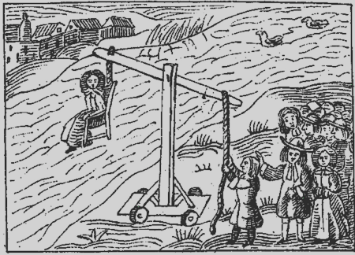
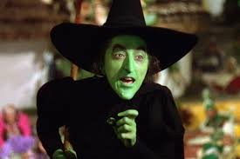

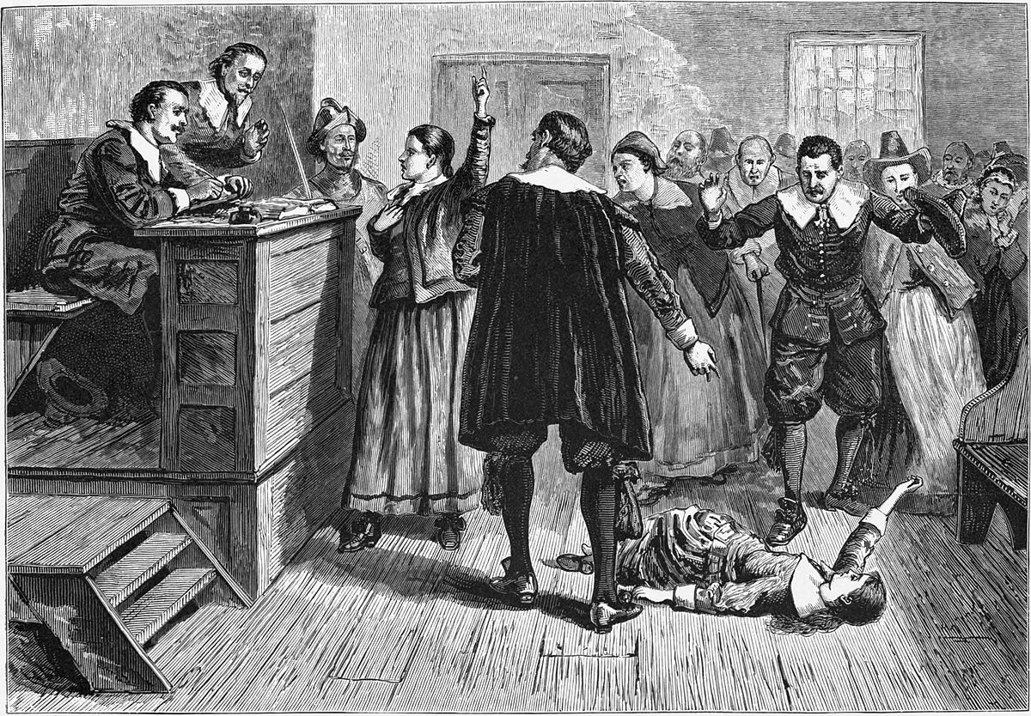

Slide 7
A better translation?

Slide 8
Comparison 2
Compare Azande witchcraft beliefs with China’s ‘moral meterology’
What are the similarities? What are the differences?

Slide 9
“Witches, as the Azande conceive them, clearly do not exist.”
Why does Evans-Pritchard think it is important to write about them?

Slide 10
Two kinds of comparison
Frontal
Lateral
Comparing ‘us’ vs. ‘other’
“Defamiliarize” the familiar, and/or familiarize the unfamiliar
Can reveal things we didn’t know about ourselves, look at ourselves in a new way
Danger: Risk of distorting the ‘other’ because reference point is ourselves;
Comparing A to B (to C, to D, etc. etc)
Each new case adds new material, new perspectives, new viewpoints
Danger: there’s no end to details, but do they add up to anything?

Slide 11
Beliefs -- Rites
Sociology of knowledge
Social order --- Epistemological Categories

Slide 12
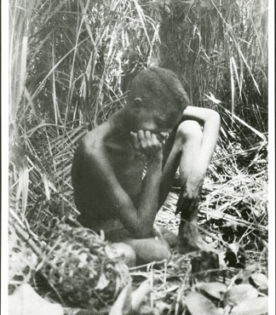
Beliefs and Rites
“the relations between these beliefs and these rites are the subject of this book” (1)
Put another way, the links between how we perceive and know “reality”, and the social institutions that we use to manage, respond to, pass judgment on and compensate for unfortunate events

